Slide 1
Deep Dive into Azure Data Factory v2
Eric Bragas

Slide 2
Section Title

Slide 3



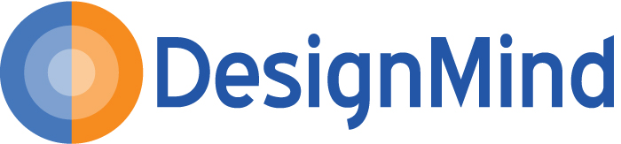






Please Support Our Sponsors

Slide 4
Local User Groups
Orange County User Group
2rd Thursday of each month
bigpass.pass.org
Los Angeles User Group
3rd Thursday of each odd month
sqlla.pass.org
Malibu User Group
3rd Wednesday of each month
sqlmalibu.pass.org
San Diego User Group
1st & 3rd Thursday of each month
meetup.com/sdsqlug
meetup.com/sdsqlbig
Los Angeles - Korean
Every Other Tuesday
sqlangeles.pass.org
SQLSaturday Los Angeles
June 9th
SQLSaturday San Diego
September 15th

Slide 5
SQL Summit
Annual International Conference
November 6 -9 | Seattle, WA
2 Days of Pre-Cons
200+ sessions over 3 days
Over 5,000 SQL Professionals
Evening Networking Activities
Discount Code: SSDISODNS

Slide 6





About Me
Senior Business Intelligence Consultant with DesignMind
Undergoing a metamorphosis (somewhat Kafkaesque) into a Cloud Data Engineer
Always had a passion for art, design, and clean engineering (I own a Dyson vacuum) and those passions have stuck with me over the years
I returned from a trip to Dresden, Germany, Prague, and Venice this week
Undergoing my Accelerated Freefall training to become a certified skydiver
And I often overuse parentheses (and commas).
https://www.linkedin.com/in/ericbragas93/
@ericbragas

Slide 7
Agenda
Overview
Components
Expressions, Functions, Parameters, and System Variables
Monitoring and Management
Q&A

Slide 8
Overview

Slide 9

Overview
"[Azure Data Factory] is a cloud-based data integration service that allows you to create data-driven workflows in the cloud that orchestrate and automate data movement and data transformation.“
Version 1 – service for batch processing of time series data
Version 2 – a general purpose data processing and workflow orchestration tool

Slide 10
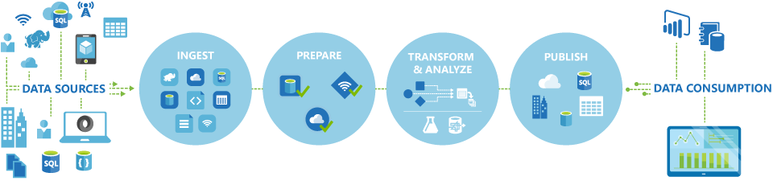

Slide 11
ETL vs ELT
Instead of extracting data, transforming in memory, then loading to a target…
…extract and load to an intermediate store, transform using a separate compute resource as needed, then load to a presentation layer
Preferable when:
High data volume that cannot be processed in memory or in full
You don’t need to transform all data
Want to take advantage of distributed processing systems, such as Hadoop or Data Lake

Slide 12
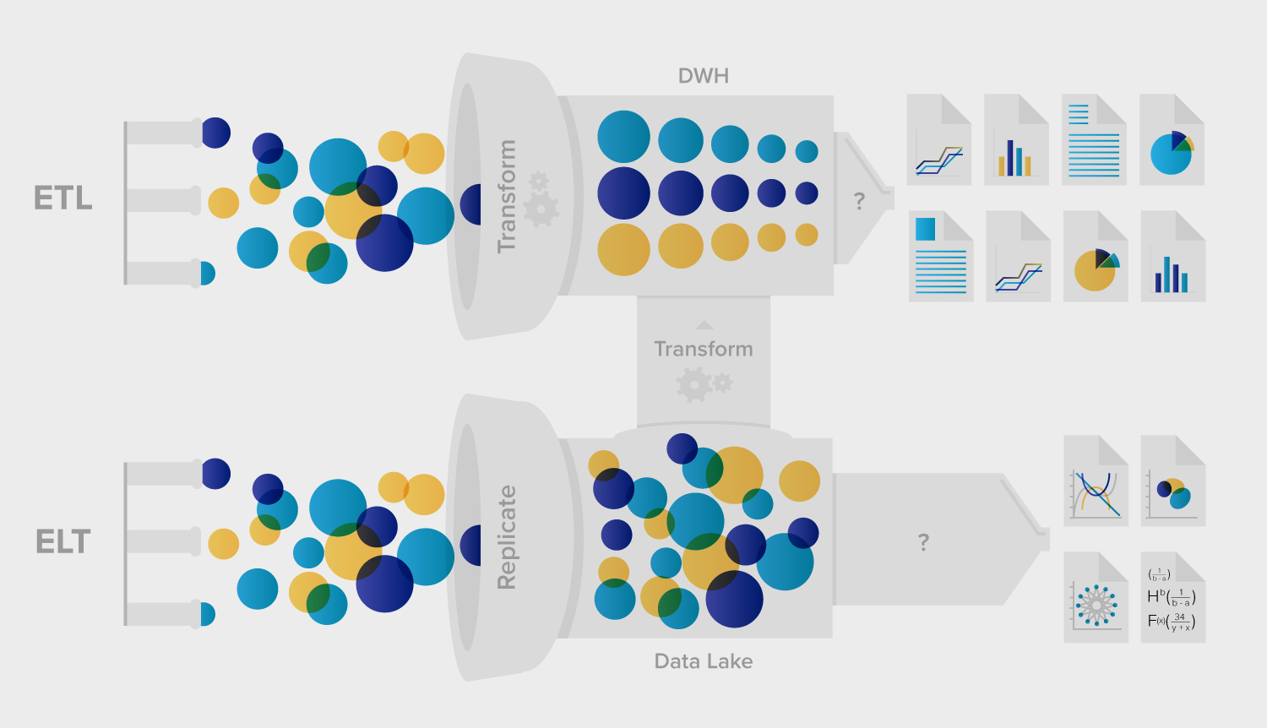

Slide 13
V1 vs V2
Component | Changes
Datasets | No longer use the "availability" property
Linked Services | Includes the new "connectVia" property which allows selection of the Integration Runtime to use (see Integration Runtime section)
Pipelines | Unit of scheduling instead of activities
Activities | Control and non-control activity types Dependencies between activities
Triggers | New scheduling component
Integration Runtime | Replacement for the Data Management Gateway
Notes:
These changes represent a fundamental shift in the way we thought about and used Azure Data Factory in version 1 to now in version 2; for the better!
https://docs.microsoft.com/en-us/azure/data-factory/compare-versions

Slide 14
Comparison with SSIS
Most common way of explaining Azure Data Factory is to call it the “SSIS of Azure”. This is both correct and inaccurate.
Concepts such as Connection Managers and Linked Servers are similar, and the idea of data movement is the same…
…but Azure Data factory uses an ELT paradigm rather than ETL. Very important to understand.

Slide 15
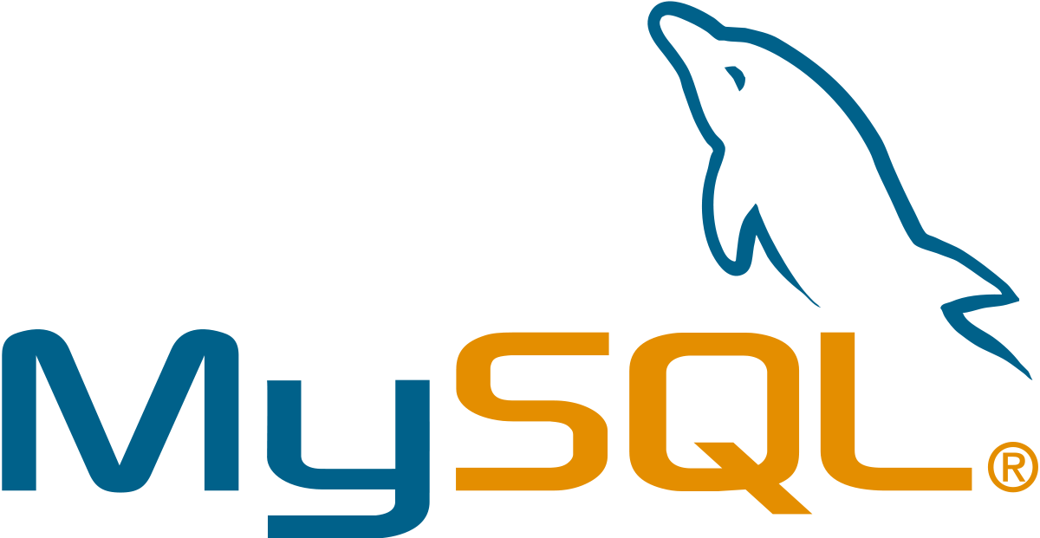


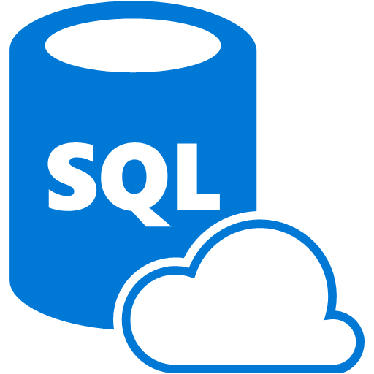

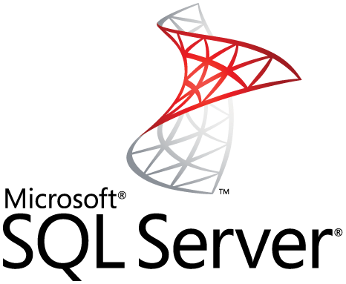


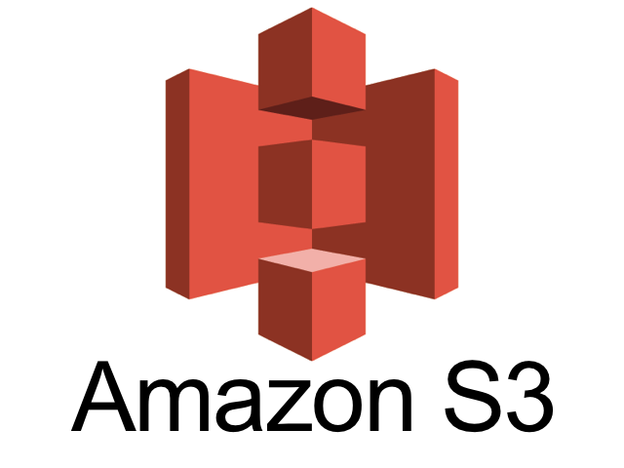
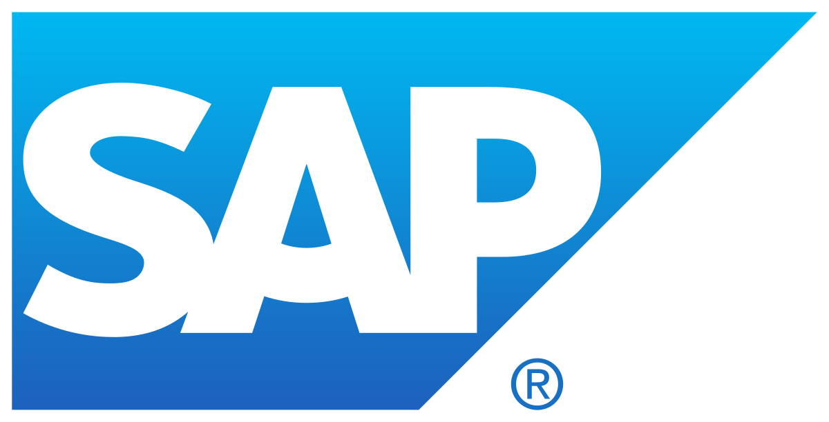
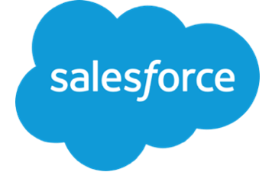
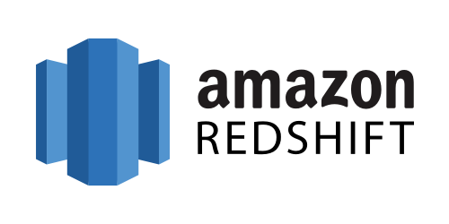
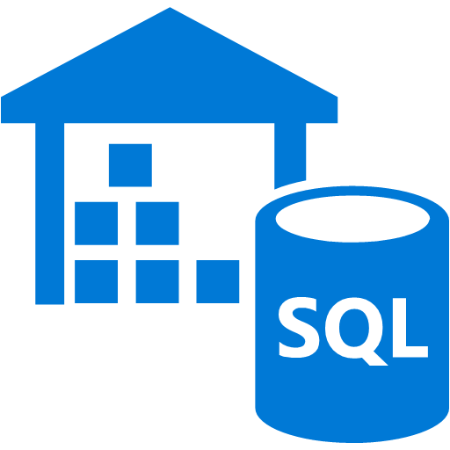
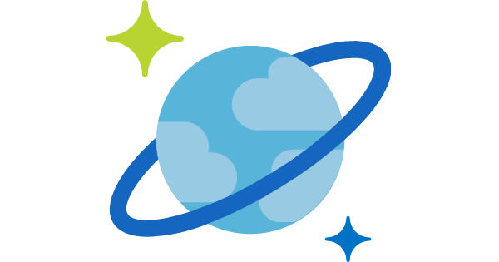

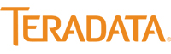
Some of the Supported Sources/Sinks
Notes:
All supported services in v1: https://docs.microsoft.com/en-us/azure/data-factory/v1/data-factory-create-datasets
Supported Services in v2: https://docs.microsoft.com/en-us/azure/data-factory/concepts-datasets-linked-services

Slide 16
Public Preview
Use at your own risk

Slide 17
Supported Regions
Regions:
East US
East US 2
West Europe
Southeast Asia
Data Factory brokers connections between systems however, so data doesn’t necessarily need to flow through the service located in these regions

Slide 18
Demo
Create an Azure Data Factory v2

Slide 19
Components

Slide 20
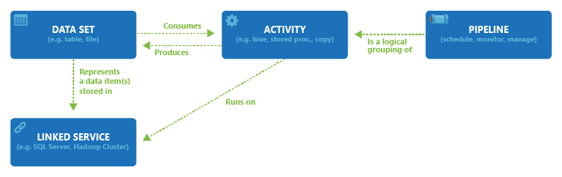
Components
The puzzle pieces from the bottom up

Slide 21
Linked Services
A saved connection string to a data storage or compute service
Doesn’t specify anything about the data itself, just the means of connecting to it
Referenced by Datasets

Slide 22
Dataset
A data structure within a storage linked service
Think: SQL table, blob file or folder, HTTP endpoint, etc.
Can be read from and written to by Activities

Slide 23
Activity
A component within a Pipeline that performs a single operation
Control and Non-control activities
Copy
Lookup
Web Request
Execute U-SQL Job
Can be linked together via dependencies
On Success
On Failure
On Completion
On Skip
Notes:
Previously in ADFv1, the Activity was the unit of scheduling as well as a unit of execution. This meant that activities had the ability to execute on different schedules within a given pipeline. This is no longer the case as the Pipeline is now the unit of scheduling and is kicked off by a trigger (or on-demand).

Slide 24
Pipeline
Pipelines are the containers for a series of activities that makes up a workflow
Started via a trigger, accept parameters, and maintain system variables such as the @pipeline().RunId

Slide 25
Triggers
Schedules that trigger pipeline execution
More than one pipeline can subscribe to a single trigger
Explicit schedule - i.e. every Monday at 3 AM, or…
Tumbling window - i.e. every 6 hours starting today at 6 AM
Notes:
Because of the change from a time-series based scheduling to explict scheduling, pipelines can no longer be setup to back-fill data using time-slices. i.e. Every day at noon starting 3 months ago. Now schedules can only start today and going forward. This means that any back-filling logic must be explicitly defined by the developer.

Slide 26
Integration Runtime
An activity defines the action to be performed. A linked service defines the target data store or compute service. An integration runtime provides the bridge between the two.
Data Movement: between public and private data stores, on-premise networks, supports built-in connectors, format conversion, column mapping, etc.
Activity Dispatch: dispatch and monitor transformation activites to services such as: SQL Server, HDInsight, AML, etc.
SSIS Package Execution: natively execute SSIS packages.
Notes:
Types of IR:
Azure
Self-Hosted
Azure-SSIS

Slide 27
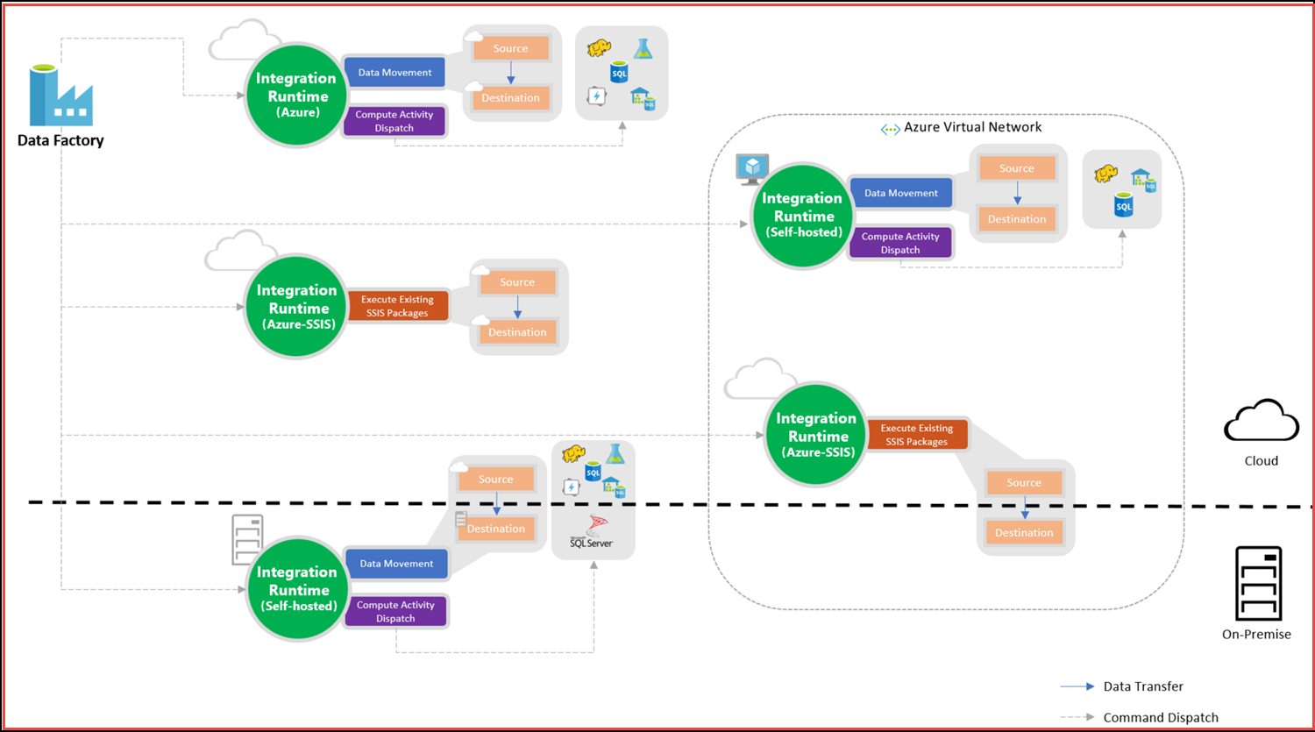
Integration Runtime (cont’d)
Types of IR:
Azure (default)
Self-Hosted
Azure-SSIS
Notes:
https://docs.microsoft.com/en-us/azure/data-factory/concepts-integration-runtime

Slide 28
Demo
Create Copy Pipeline

Slide 29
Expressions, Functions, Parameters, and System Variables Oh my!

Slide 30
Expressions
Syntax evaluated during execution of an activity that allows for dynamic changes to the property configurations they are used within
Reference things such as parameters, the output of previous activities, and provide access to the current item being iterated over by loops
@pipeline().parameters.myParam
@formatDateTime(item().value.myDateAttr, ‘yyyy-MM-DD’)
Notes:
When debugging a pipeline, you can’t really see the result of an expression, so you have to be attentive to figure out how it’s resolving
https://docs.microsoft.com/en-us/azure/data-factory/control-flow-expression-language-functions

Slide 31
Custom State Passing
Custom State Passing refers to the ability for a downstream activity to access the output of an upstream activity
Expressions can be used to access these output states and change configuration of the currently executing activity
@activity(‘myUpstreamActivity’).output.rowsRead

Slide 32
Functions
String – string manipulation
Collection – operate over arrays, strings, and sometimes dictionaries
Logic – conditions
Conversion – convert between native types
Math – can be used on integer or float
Date
There is not currently a way to add or define additional functions

Slide 33
Parameters
Key-value pairs that can be passed to a pipeline when it is started or a dataset when it is used by an activity
Need to first be configured to receive a parameter with a specific name and data type before the calling component can be configured to pass a value.
Two types of Parameters:
Pipeline
Dataset
@pipeline().parameters.myParam
@dataset().myParam

Slide 34
System Variables
System Variables are read-only values that are managed by the Data Factory and provide metadata to the current execution
These can be used for custom logging or within expressions
They can be either Pipeline-scoped or Trigger-scoped
@pipeline().DataFactory
@trigger().scheduledTime
Notes:
https://docs.microsoft.com/en-us/azure/data-factory/control-flow-system-variables

Slide 35
Demo
Create Dynamic Pipeline

Slide 36
Demo
Create Incremental Load Pipeline

Slide 37
Development Tools
Currently, there is no Visual Studio extension for developing Azure Data Factory v2 pipelines. There is one for v1, but this doesn't allow deployment to v2 Factories. Instead, the preferred development tool has been to use the Azure Portal.
Tools:
Azure Portal (Development UI)
PowerShell
REST API
ARM Template
Python SDK

Slide 38
Azure Portal – Author and Monitor
In order to save your work, you must publish your pipeline
Currently supports integration with Visual Studio Team Services repositories, and GitHub repos are coming soon.
Provides a "code" viewer which allows you to view the JSON configuration documents that are generated as you create components using the visual editor. However, this does not allow you to modify the code, so you must figure out how to make the changes you want visually (not always easy).
Since you cannot edit JSON in the code viewer, and the GitHub integration is not yet operational, we have been managing source control and deployments using the ARM Template Importer and Exporter
The built in debugger allows you to test your pipeline before publishing, however beware that this is an actual execution and data will be modified
The monitoring view and editor view are grouped together which can make the develop-debug process quite smooth. Much smoother than it used to be when developing in Visual Studio for v1 and having to deploy, resume, then wait for something to start.

Slide 39
PowerShell Module (AzureRM)
Nice if you want to quickly spin something up, or tear something down and create it again
Not ideal for team development
Great for monitoring and management

Slide 40
Development Recommendations
Use separate linked services for dev/test/prod source systems. Allows for quick and easy swapping of dataset targets
Use strong naming conventions
Use ARM Templates for deployments between Data Factory services
Source control your ARM templates using Azure Portal ARM Template Export, or VSTS integration
GitHub integration coming soon!

Slide 41
Design Patterns
Delta/Incremental Loading
Dynamic table loading
Custom logging
Using database change tracking
Notes:
https://docs.microsoft.com/en-us/azure/data-factory/tutorial-incremental-copy-overview
https://docs.microsoft.com/en-us/azure/data-factory/tutorial-incremental-copy-multiple-tables-portal

Slide 42
Monitoring and Management

Slide 43
Tools for Monitoring
Azure Portal – Author and Monitor
PowerShell

Slide 44
Deployment
Use separate dev/test/prod resource groups and Data Factory services
Deploy to separate services using ARM Templates (until VS extension available)
Can also script deployments using PowerShell or Python SDK

Slide 45
Debugging
Use monitor, drill into a pipeline and view error messages directly on the activity
Cannot see the result of an evaluated expression, so you may need to be clever
Depending on the error, you may get a message that is completely useless. Good luck.

Slide 46
Deploying SSIS to Azure-SSIS Integration Runtime
Allows deployment and execution of native SSIS packages
Use Azure SQL Database to host SSISDB Catalog
Limitations exist with using the Azure SDK for SSIS
Cannot execute U-SQL jobs
Lift-and-shift option for existing SSIS packages

Slide 47
fin.

